Slide 1
NAU Fume Hood Final Presentation
Fume Hood Team – Team 5
ME 486C
Talal Alshammari, Zachary Bell, Bryce Davis, Shirley Hatcher
July 31, 2020

Slide 2


Project Introduction
Project Sponsor and Client – Dr. Zachary Lerner, NAU’s Biomechatronic Lab
Mobility Impairment Device Fabrication
Project Objective- Neutralize threats associated with carbon fiber
Laboratory Fume Hood ensures safe working space
Figure 1. Mobility Impairment Device
Shirley

Slide 3
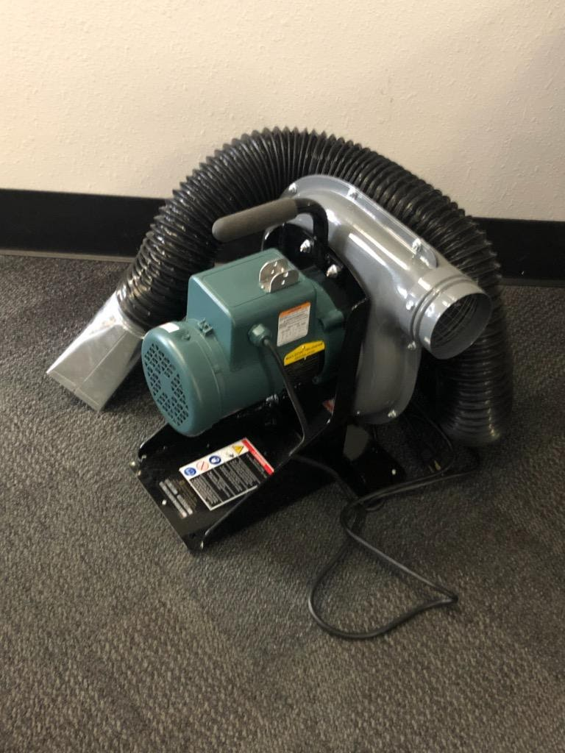
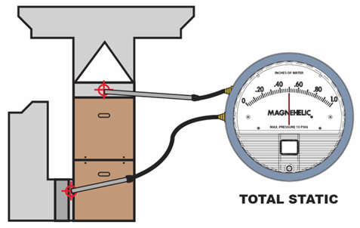
Project Problem Understanding –
Requirements & Specifications
Compatible with EBR 500 Exhauster
Portable within Lab (Tabletop Size)
Durable, Reliable, and Safe to Operate
Filter Safety Operational Monitor
Figure 2. EBR 50 Exhauster
Figure 3. Filter Monitor Demonstration
Shirley
3

Slide 4
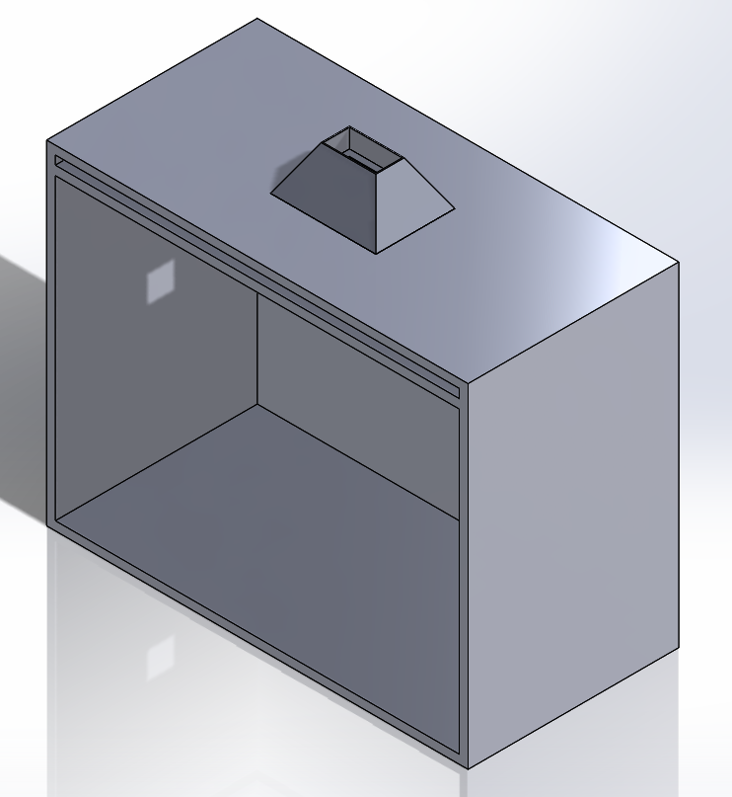
Fume Hood Shell Shape - Design Solutions Considered
Our fume hood shell considerations included a flat ceiling shell, a round shell and a rounded pyramidal shell.
Flat Ceiling Shell
Simplest design to manufacture
Increased vortex eddies and dead zones from sharp edges and corners
Loss of efficiency and suction at top of fume hood shell
Easy to meet design specifications of 4x3x2 feet
Figure 4: Flat Ceiling Fume Hood Shell design
Bryce

Slide 5
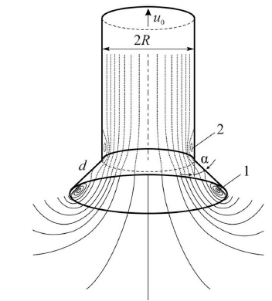
Fume Hood Shell Shape - Design Solutions Considered
Rounded Shell
Complex manufacture processes
Vortex eddies from rounded edges along outer edges of shell
30-50% reduction in drag than sharp edged shells
Difficulty in attaching EBR 50 exhauster to the shell
Not a common design in current market models
Figure 5: Eddies and re-circulation zones in rounded shell design
Bryce

Slide 6
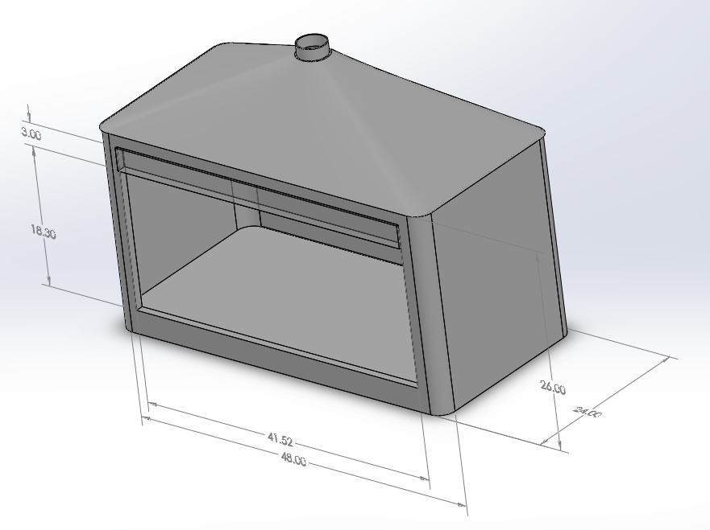
Fume Hood Shell Shape - Design Solutions Considered
Rounded Pyramidal Shell
Simple manufacture processes
Reduced vortex eddies by using rounded edges
Increased suction and efficiency from pyramidal shape
Most common and efficient shape in current models
Figure 6: Rounded pyramidal shape preliminary hood design
Bryce

Slide 7
Fume Hood Shell Material - Design Solutions
Carbon fiber is an electromagnetically charged metal that corrodes other types of metals rather quickly. This type of corrosion is often referred to as Galvanic Corrosion [1]. With this information we considered three different materials in our shell design.
Titanium, Titanium Alloys, Stainless Steel
Extensive testing shows titanium and its alloys are the best metal to use in reducing the effects of galvanic corrosion
Titanium is expensive and would increase manufacture cost
While stainless steel reduces the effects of galvanic corrosion it is, however, more susceptible to pitting and crevice corrosion
Plastic Materials (Polyethylene)
Cost-effective material that eliminates the effects of galvanic corrosion
Reduced molding and manufacture cost
Lightweight and portable
Bryce

Slide 8
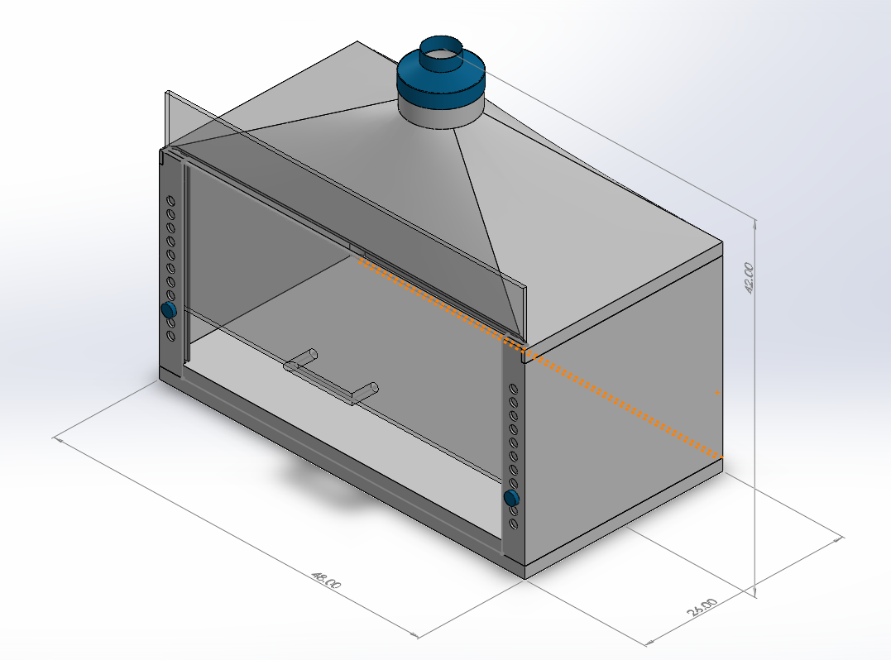
Fume Hood Shell and Material - Design Solution Chosen
From our analytical research and client preference we decided to focus our efforts on designing a fume hood with a rounded pyramidal shape.
This decision was made using current market research and computational analysis alongside our team's client needs and engineering requirements.
Our fume hood will be manufactured using polyethylene sheets that will be molded and shaped as a part of our manufacturing processes.
Figure 7: Rounded pyramidal shape final hood design
Bryce

Slide 9
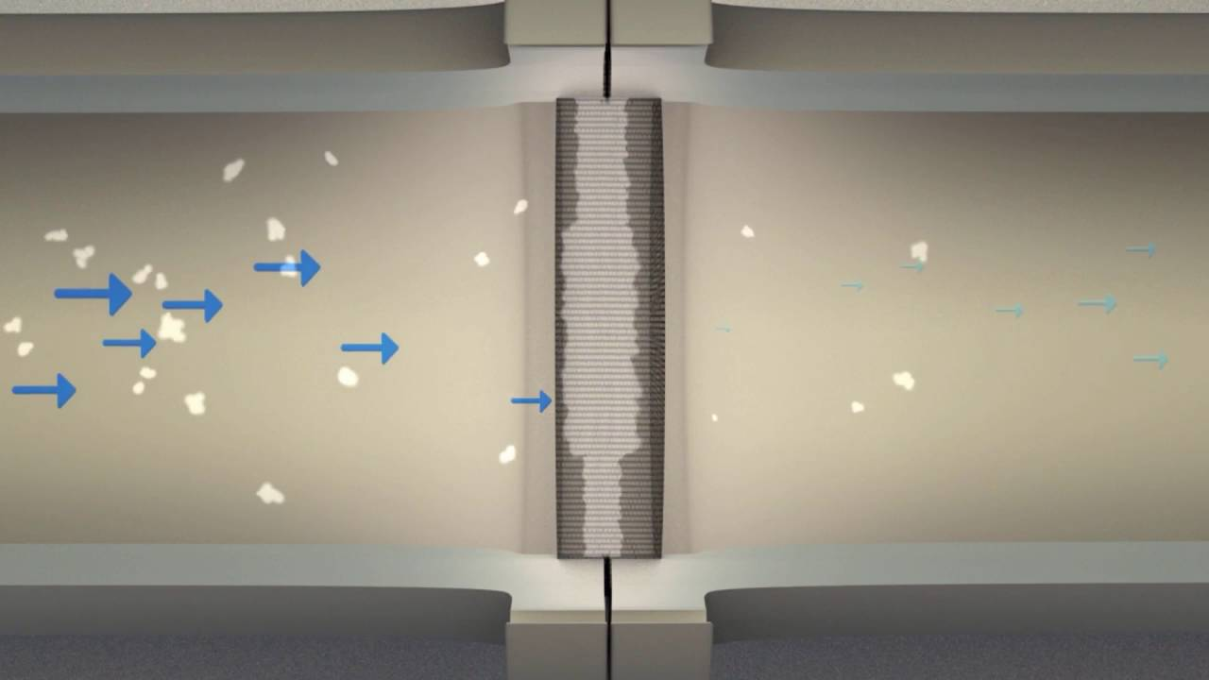
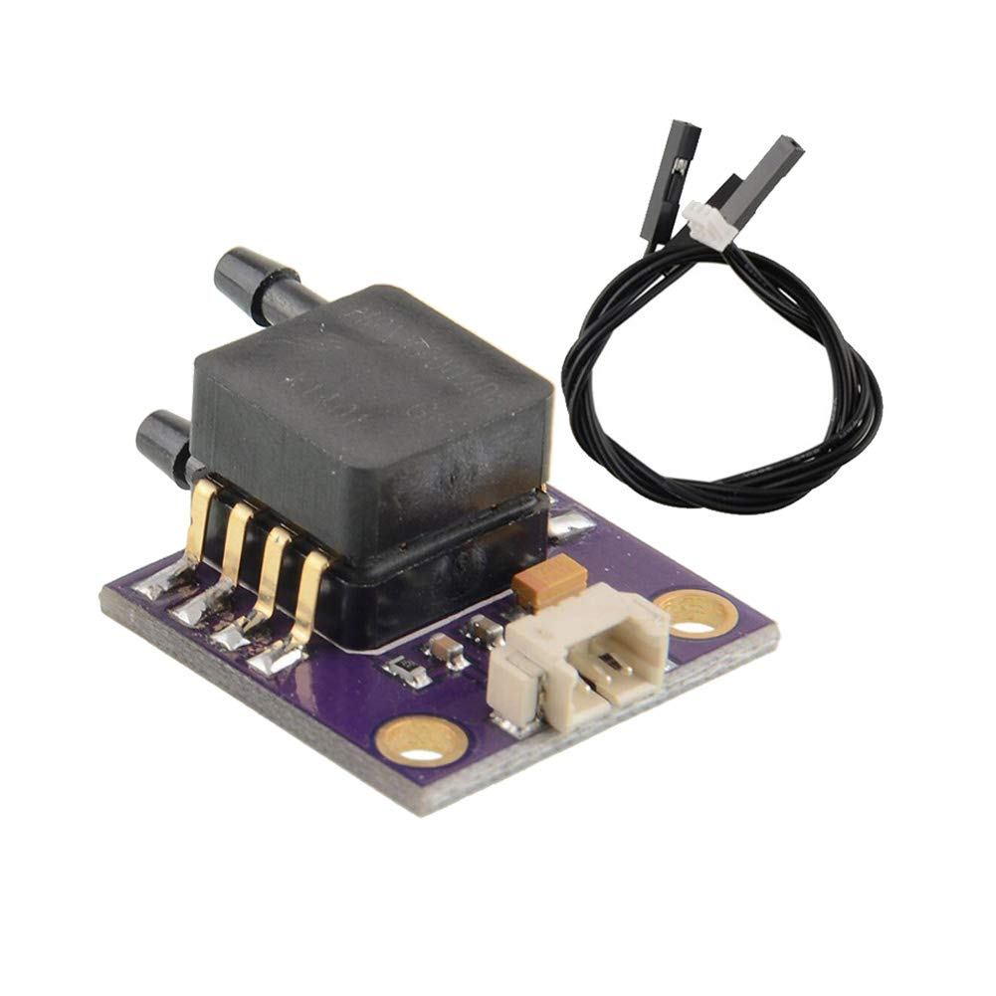

Fume Hood Filter Monitor - Design Solution
Safety Operational Filter Monitor
Differential Pressure Device
Arduino Uno Rev 3
Figure 8. Carbon Fiber Particulate Capture Demonstration
Figure 10. Arduino Uno Rev 3
Figure 9. Differential Pressure Transducer
Shirley
9

Slide 10
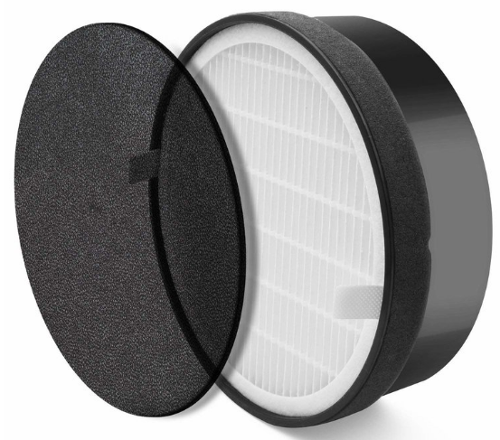
Fume Hood Filter - Design Solution Chosen
Our chosen filter, The Levoit LV- H132 Filter, is an H-14 hepa filter with a three-stage filtration process.
Stage one is a fine preliminary filter that captures and neutralizes airborne bacteria, mold and fungi.
Stage 2 consists of the true HEPA filter that captures and collects the large carbon fiber particles
Stage 3 is an activated carbon filter that assists with the neutralization of all odors and epoxy fumes that are present within the system.
This 7.5” diameter filter is compatible with our design solutions for the fume hood shell while also being easily replaceable.
Figure 11: Levoit LV- H132 3-stage HEPA filter
Bryce
10

Slide 11
Design and Decision Making
Design and decision making were conducted through a series of methods which included charts, graphs, and client input and feedback.
Our fume hood team received helpful design, research, and analysis input from a wide variety of NAU professors regarding pressure systems, design solutions, and Arduino information. These insights were then further researched, analyzed, and proven by our team with theoretical testing and analysis.
Critical design decisions came from client feedback on compiled and presented research and analysis.
Bryce
11

Slide 12
Final Manufacturing Processes
Fume hood sections will be made from high density polyethylene.
Fume Hood Sash will be made from a clear polycarbonate sheet. The pull handle on the front of the sash will be attached using standard parts according to its manufacturer.
Each fume hood section can be manufactured either through rotational molding or by machining HDPE sheets.
The Sash “knobs” and the reduction cap will both be 3D printed. For the size of the parts 3D printing will be quick and will still result in a high-quality product.
Customer Requirements compared to Final Product
Zach
12

Slide 13
Customer Requirements compared with Final Product
Safety and Durability
The material the device is built from ensures it being durable. The design of the device has been developed with industry safety standards in mind.
Compatibility and Portability
The device’s outlet has been designed with the filter and exhaust fan in mind. The reduction cap on top of the filter ensures the exhaust fan will securely sit on the device exhaust port.
Removal of particulates and fumes
The filter that is being used will ensure that 99.97% of all particulates and fumes are being removed from the device.
Filter assessment capabilities
The filter assessment system does work at a very basic level however it does need to be tested and adjusted.
Budgetary constraints
At the current state, the device is within the budgetary constraints with rotational molding but is overbudget if premanufactured sheets are used.
Zach

Slide 14
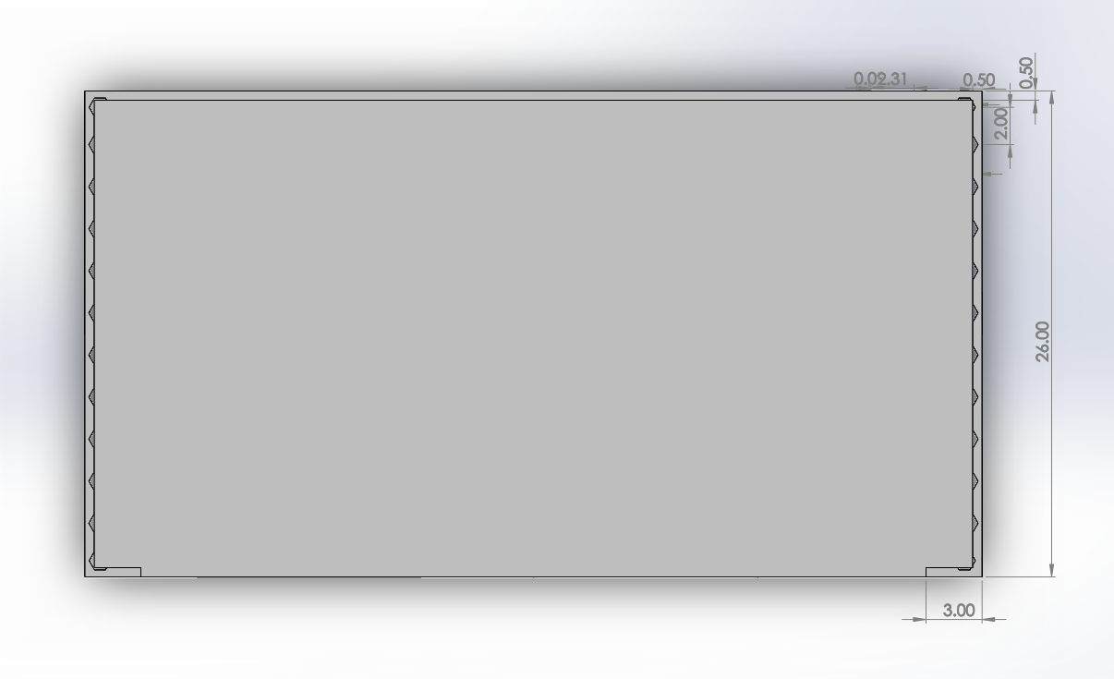
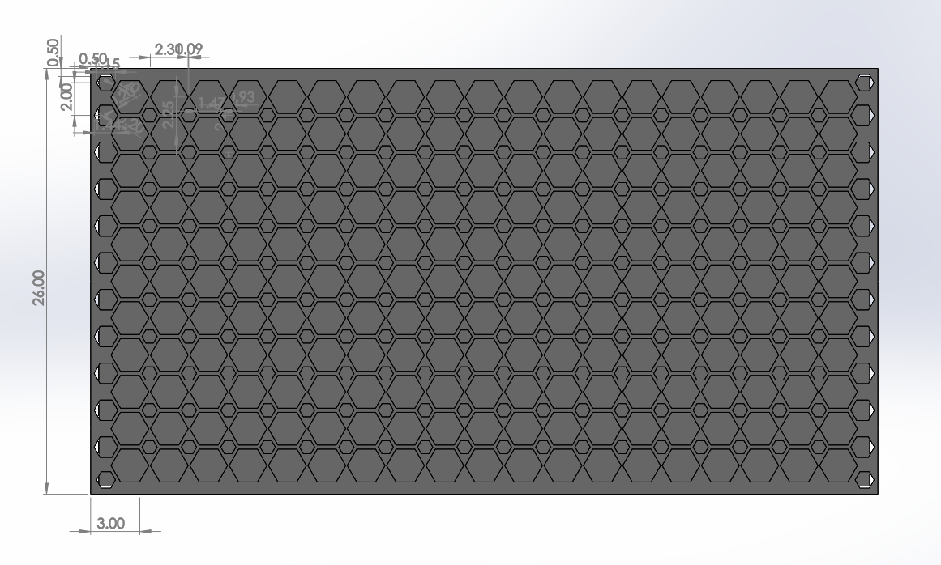
Manufacturing Processes
Figure 12: Bottom Section of final Model
Figure 13: Bottom Section of final Model Hexagonal Lattice
Zach
Zach
14

Slide 15
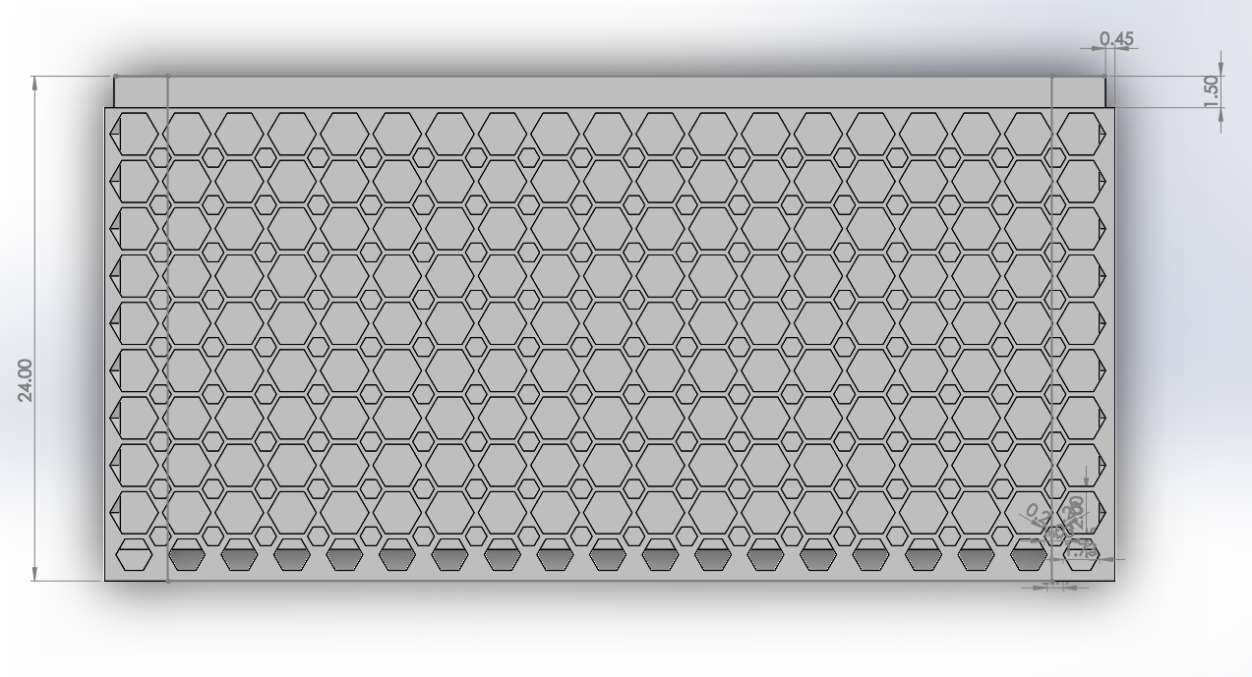
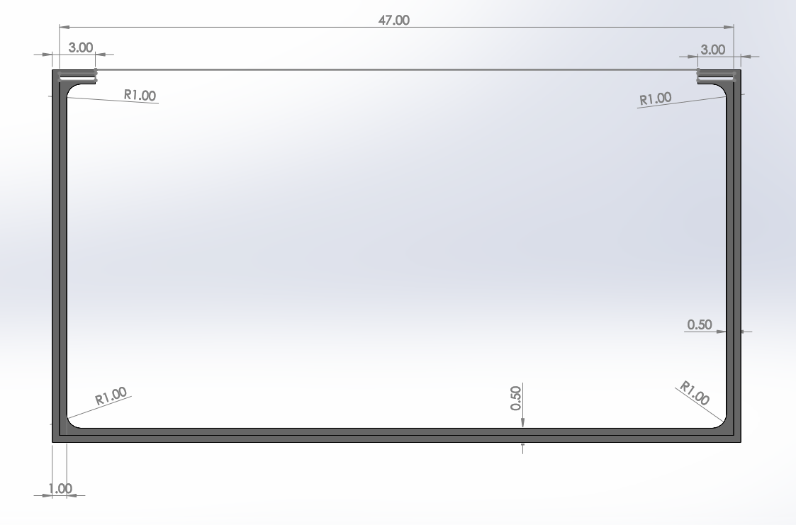
Manufacturing Processes- 3D Models
Figure 14: Side View Lattice
Figure 15: Side Section of final Model Dimensions
Zach
Zach
15

Slide 16
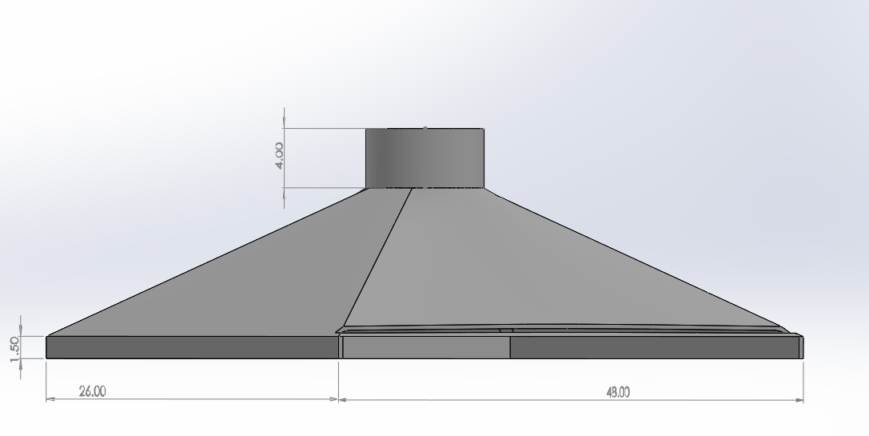
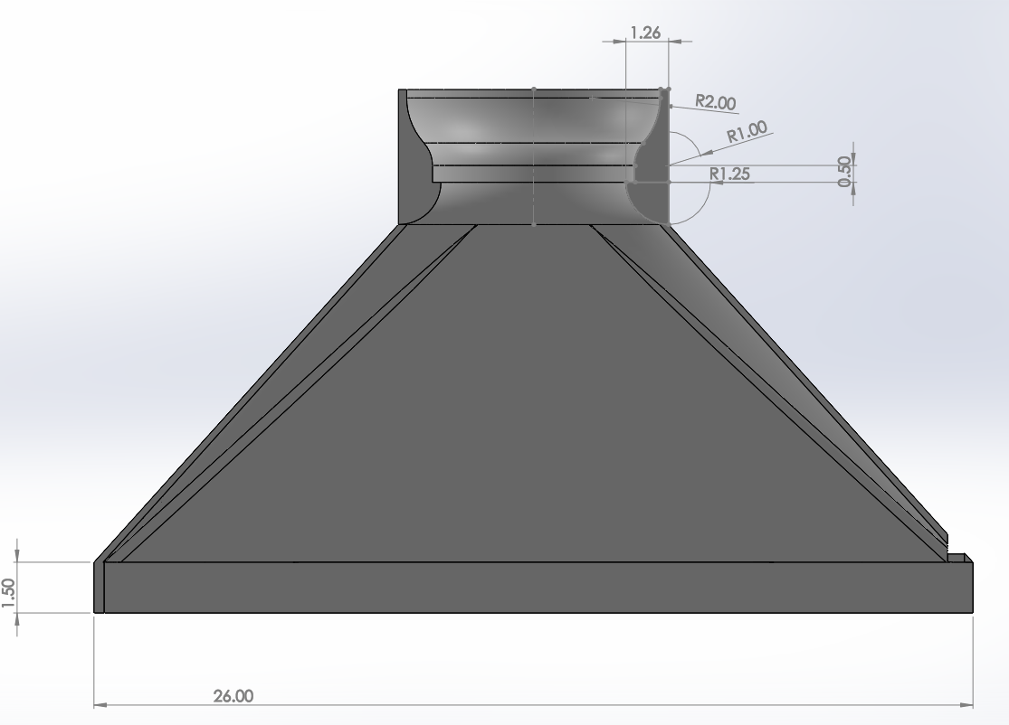
3D models
Figure 16: Pyramidal Section of final Model
Figure 17: Top section side view of final Model
Zach
Zach
16

Slide 17
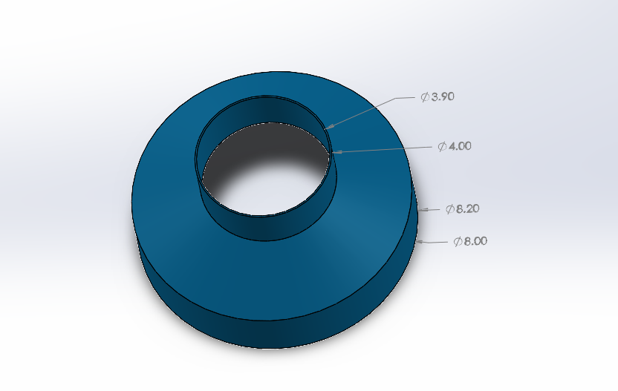
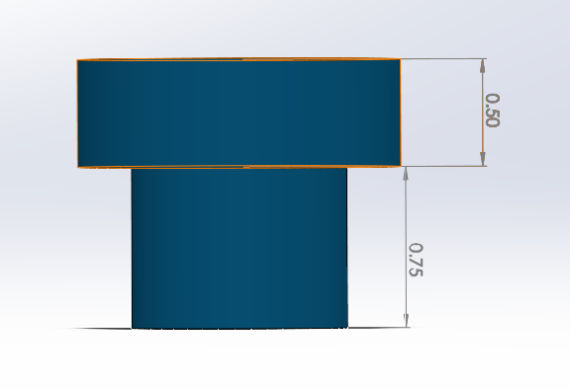
3D models
Figure 18: Final Model of Reducer
Figure 19: Final Model of Reducer Side View
Zach

Slide 18
Budget
Cost of HDPE
HDPE sheets – $561.97
HDPE raw material for rotational molding – $60
Costs of 3D prints
Reduction cap – $5
Knobs - $0.75
Cost of sash
Polycarbonate sheet – 76.97$
Pull Handle – 20$
Cost of Pressure system
Arduino rev 3 – 23$
Pressure sensors – 30$
wiring and LEDS – 14$
Cost of Misc. Items
O-ring – 9$
Zach
18

Slide 19

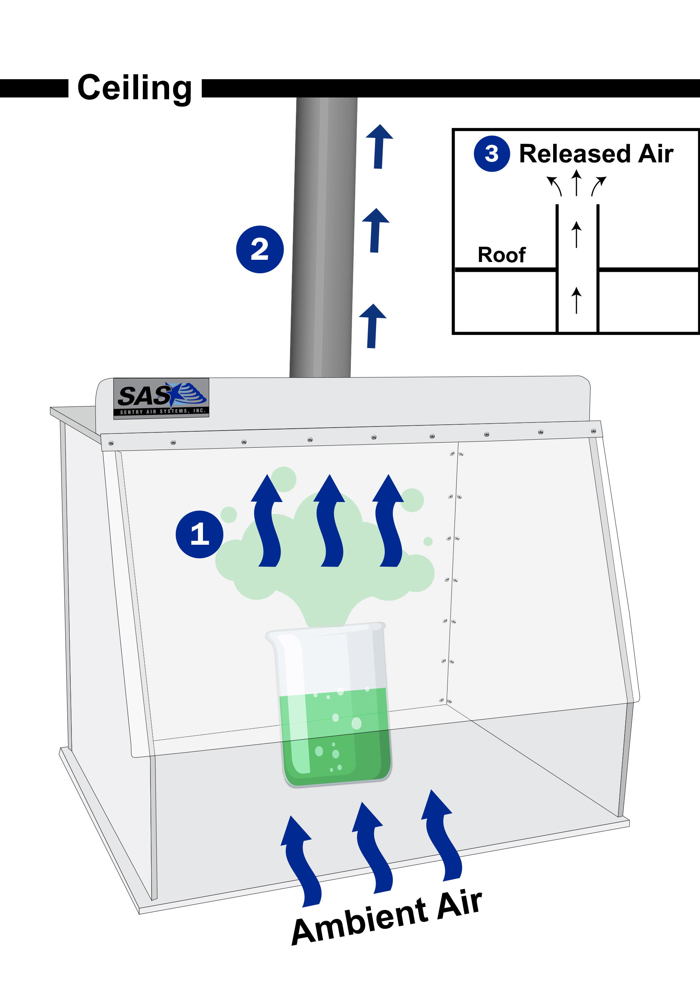
Testing Procedures – Fume Hood
Thermo-Anemometer velocity probe to
measure air velocity and volumetric flow
Colored Smoke to demonstrate Flow Patterns
and Ventilation
Average Face Velocity with probe at opening
of 18 in should correlate to 100 cfm
Smoke can not exit hood
Figure 20. Velocity
Probe
Figure 21. Smoke Testing on
Fume Hood
Shirley
19

Slide 20
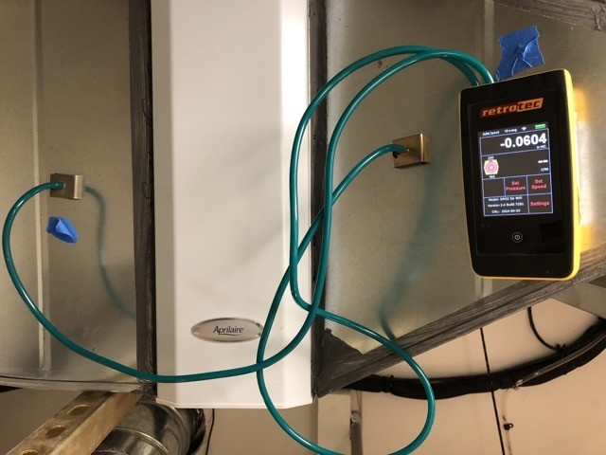
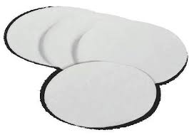
Testing Procedures – Filter Safety Monitor
Filter must be changed when the Pressure Drop Doubles
Two Static Pressure Probes
First Probe at Inlet of Filter Airflow
Second Probe at Outlet of Filter Flow
Fine Particle Filter Pads to Ensure
Readings are Safe
Figure 22. Inlet and Outlet Static Pressure Taps
Shirley
Figure 23. Fine Particulate Capture Filter Pads

Slide 21
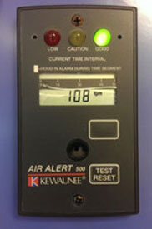


Future Work – Filter Safety Monitor
Correlate Pressure Drop to Capacity of the Filter in Real Time
Program Arduino Uno to Display the Capacity Percentage
LCD Display to Provide Permanent Display of Readings
to Ensure Operational Safety
Figure 26. Permanent Display
Figure 24. Wireless real time data
Figure 25. LCD Display Set up
Shirley
21

Slide 22
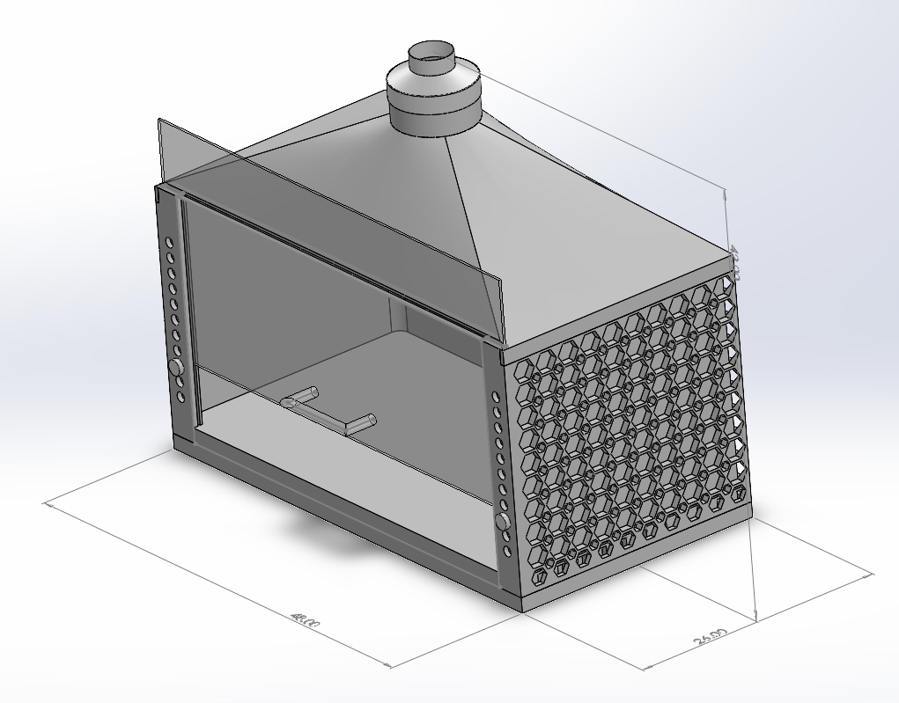
Future Work
Future Work- Manufacturing
Manufacturing cost analysis.
(Prefabricated parts or outsourcing the design to be made or shipped to the client.)
Device Assembling.
Device Testing.
Figure 27: ISO View Final design with hexagonal siding
Talal
22

Slide 23
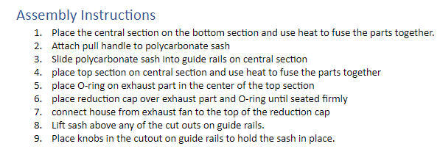
Future Work – Device Assembly
After manufacturing the parts of the fume hood, the client needs to assemble the device according to the manual [1].
Figure 28: Assembly Manual instructions
Talal
Talal
23

Slide 24
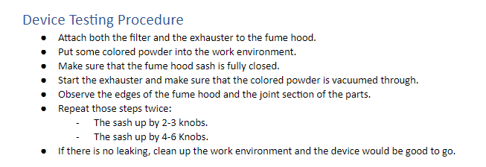
Future Work – Device Testing
As presented in the Manual, the device testing is critical to ensure the safety of the work environment after assembling the fume hood.
Figure 29: Device Testing Procedures
Talal
24

Slide 25

Thank You!

Slide 26
References
[1] Bossard, "Galvanic Corrosion in Carbon Fiber Materials," 19 December 2014. [Online].Available: https://provenproductivity.com/galvanic-corrosion-carbon-fiber-materials-2/#. [Accessed 30 July 2020].
26

